Slide 1
Common Class: Block Chain
How use of Blockchain can provide benefits to supply chain industry?
Adopted from:

Slide 2
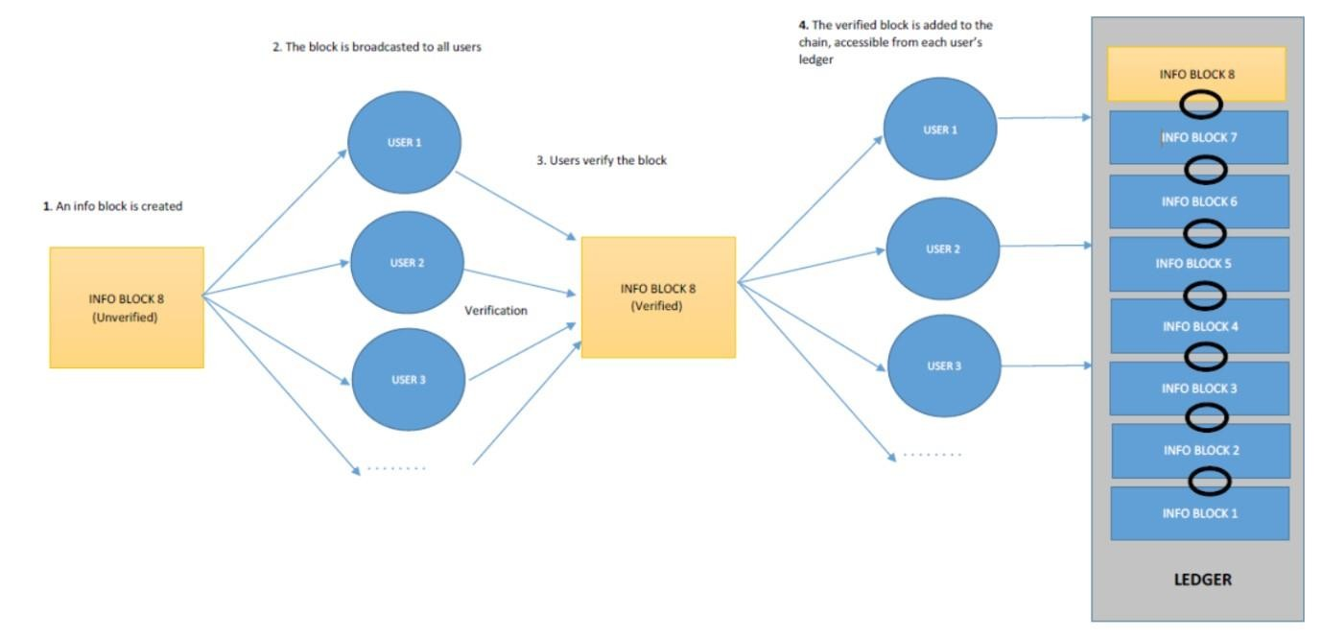
Blockchain process

Slide 3

Public Ledger (A Small Example)
2

Slide 4
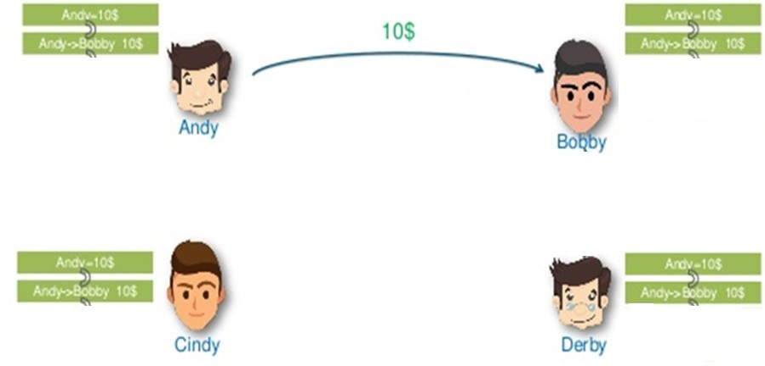
Public Ledger (A Small Example)
3

Slide 5
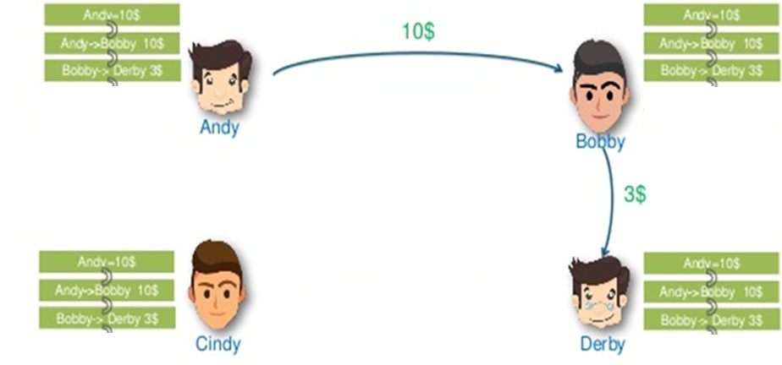
Public Ledger (A Small Example)
4

Slide 6
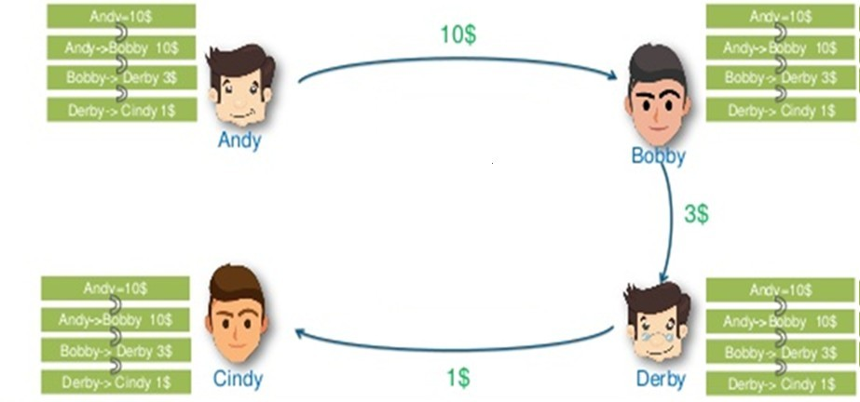
Public Ledger (A Small Example)
5

Slide 7
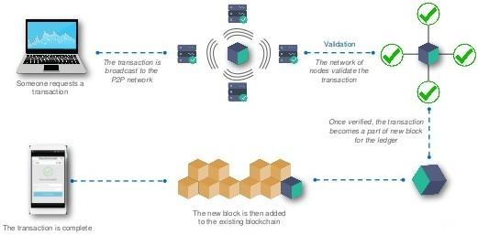
How Blockchain Works?
6

Slide 8
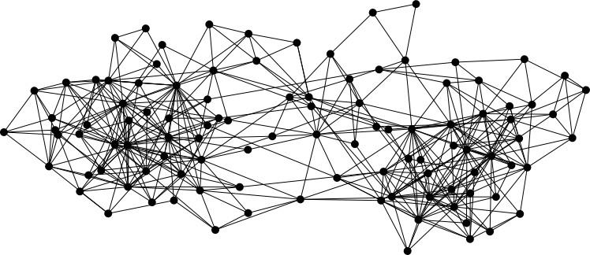

Block chain example: peer-to-peer system
When Alice wants to perform an action
she broadcasts the action information as a transaction to all nodes in the networks
signed by Alice
H( )

Slide 9
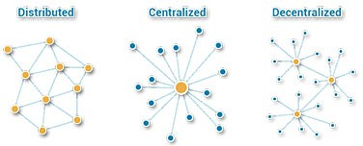
Block Chain in SCM
•
Uses Distributed Ledger Technology(DLT) for secure and permanent transaction(financial transactions, contracts, physical assets, supply chain info, etc.) executed between the parties. Facilitates the shift of ledger from centralized to decentralized and distributed system.
Logistics : Data sharing among all the participating stockholders make the system more transparent and secure.
•
•

Slide 10
How consensus could work
At any given time:
All nodes have a sequence of blocks of transactions they’ve reached consensus on
Each node has a set of outstanding transactions it’s heard about

Slide 11



How consensus could work
Tx
Tx
…
Tx
Tx
Tx
…
Tx
Tx
Tx
…
Tx
Tx
Tx
…
Tx
Consensus protocol
Tx
Tx
…
Tx
Tx
Tx
…
Tx

Slide 12
Why consensus is hard
Nodes may crash
Nodes may be malicious
Network is imperfect
Not all pairs of nodes connected
Faults in network
Latency
No notion of global time

Slide 13

Features and advantages
Confidentiality: Blockchain technology decentralizes ledger to enhance security and transparency. However, it raises many other concerns with the privacy, since all the user on the network can view all the activities. As the result, Some block chains try to protect the user privacy and their data by using advance level cryptography and pseudonymous addresses to hide some a activity features.
Security: A distributed leader very much increases difficulty for the cyber attack, which extensively makes data security stronger.
Transparency: It is used in the distributed consensus concept, where every user is capable to read entire activity history, which in turn increases much batter data transparency.

Slide 14

Features and advantages
Immutability: after the activity or transaction is validated by the blockchain system, it can no more be amended or reversed. In this view, data integrity can substantially decrease auditing cost.
Traceability: Access to time stamp transaction record allows users to efficiently and effectively trace information history.
Efficiency: Block chain may replace requirement for centralized database and disintermediation may be achieved. That’s why it is no more required to have trust worthy mediator, such as in banking sector, to maintain database, therefore both the transaction processing cost and time can be decrease significantly.

Slide 15
How the Blockchain helps Supply Chain industry
Assigning: It is secure verification of certificate and various physical products properties. Example check that food product trade is fair or organic.
Recording: Easy to record transfer and quantity of assets such as trailers, containers, pallets and more as they are move between the supply chain nodes.
Linking: Easy to use digital tags, bar codes, serialize every physical items (Example use RFID technology).
Tracking: It enables business to track change orders, shipment notifications, purchase orders, receipts, or any other documents related to trade.
Sharing: Business shares all the product related information about assembly, manufacturing process, maintenance and delivery to their vendors and suppliers.

Slide 16
Recommendation
Based on our research we suggest Blockchain technology may crucially be a very good solution for the particular supply chain industry, but it is not yet complete for mass implementation.
The clear cost of developing and running present capacity and capacity that supply chain will need is massive.
Still Blockchain technology is not yet able to collect information across a high number of non-trusted parties.
It is evolving and its benefits can ultimately transform the industry.

Slide 17
Recommendation
As recommended by one of the author Mr. Shermin Voshmgir in his book title “Token Economy: How Blockchains and Smart Contracts Revolutionize the Economy”, when we discus about Blockchain, most communities look to focus on positive potentials.
Any technology is always just like a tool. How we utilized that tool is a question (Voshmgir, 2019)

Slide 18
Conclusion
Overall it seems that supply chain management and Blockchain technology were built for each other.
In reality all the current supply chain flow risks are very easy to mitigate by the block chain technology.
I suppose that this is one of the most probable industry domain that Blockchain may modify and interrupt for better.
Management system based on Blockchain can be the standard in the future

Slide 19
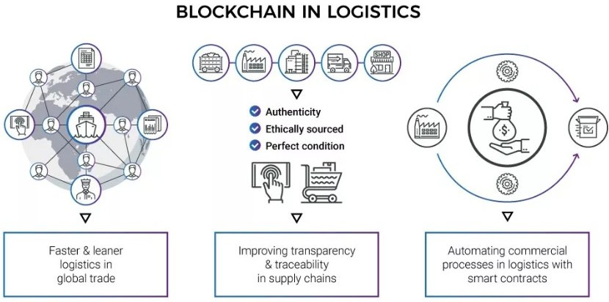
Block Chain in Logistics
According to the World Economic Forum, reducing supply chain barriers could increase global gross domestic product (GDP) by nearly 5% and global trade by 15%.

Slide 20
Traditional Methods challenges addressed by Block chain

Slide 21
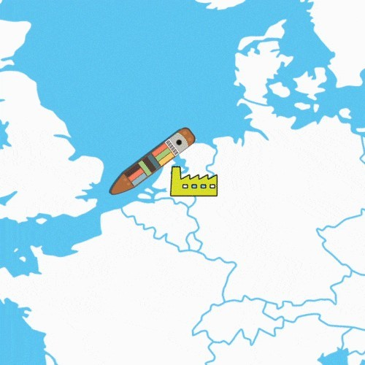

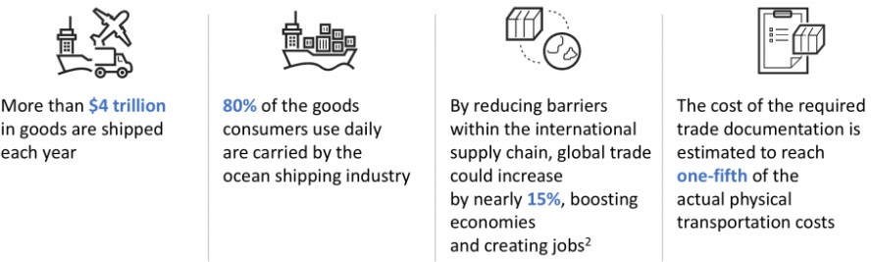
Case Study of Maersk and IBM
Both companies intended to develop the fully integrated secure and efficient system using block chain technology.
Current industry challenges
Current global trade at USD $1.8 trillion annually with potential savings from more efficient process of ~10%.

Slide 22
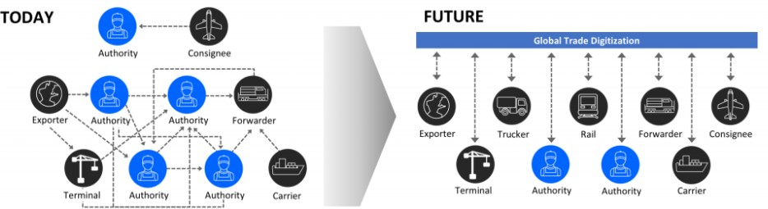
Present situation In Maersk: Highly inefficient and burdened by paper- based processes
Complex, cumbersome and costly
Single source of the Truth
Fast, Secure access
Inconsistent, Blind spots
Manual, Time- consuming, paper based
Better Risk assessment
Trusted cross organizational workflows

Slide 23
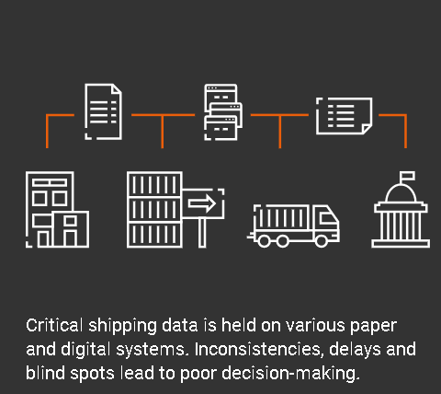
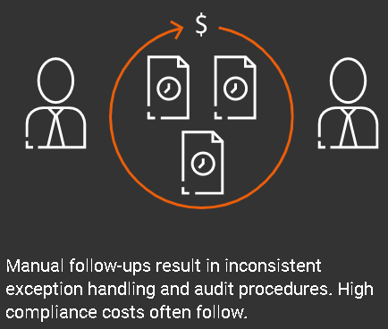
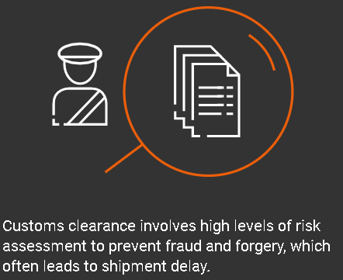
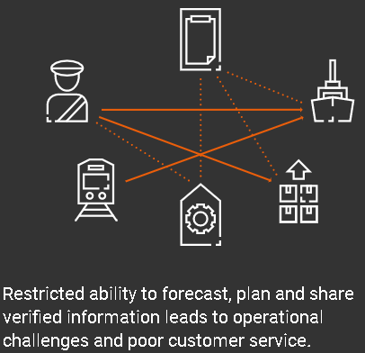
Challenges with global trade
Data is Trapped in organizational Silos
Time consuming Processes
Operational Complexity and costly
Custom clearance is time consuming and not transparent

Slide 24
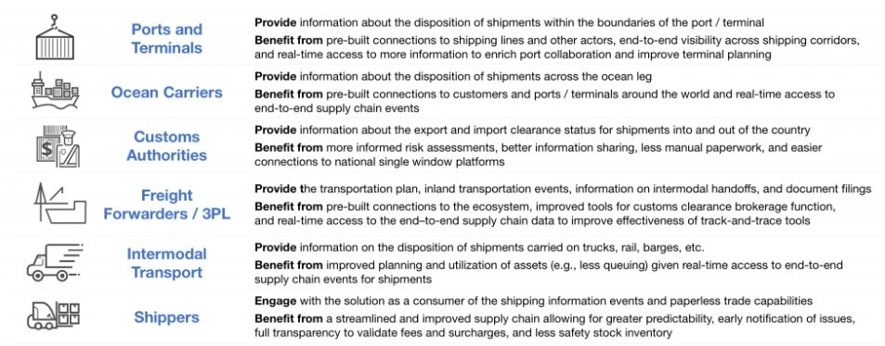
Maersk and IBM Actors considered in framework
IBM replaces current EDI( electronic data interchange) and paper- based system, which resulted long container claim in receiving yards sometimes for weeks.
Over the past 18 months, Denmark-based Maersk has been piloting the blockchain platform with various customers, including DuPont, Dow Chemical, Tetra Pak, Port Houston, Rotterdam Port Community System Portbase, the Customs Administration of the Netherlands and U.S. Customs and Border Protection. IBM's blockchain is based on the open-source Hyperledger Fabric 1.0 specification created by the Linux Foundation

Slide 25
Benefits to actors(shippers/cargo owners)
Problems | Solutons
Excessive capital tied up in inventory | Reduces the need to maintain safety stock by providing greater visibility and predictability in the supply chain
High administrative costs for managing supply chain transactions | Eliminates manual processes
Lack of trust regarding the fees on freight invoices | Full, trusted visibility on the end-to-end journey of a shipment
High IT costs for integrating with service providers | Single, standards-based publish/subscribe interface for obtaining visibility data
High compliance costs for international trade transactions | Eliminates the need to hand-carry physical paper forms to obtain stamps
Border delays due to lost/erroneous paperwork | Improves document turnaround times
High costs charged by customs brokers and freight forwarders for clearance services | Simplified process and workflow-driven compliance policies

Slide 26
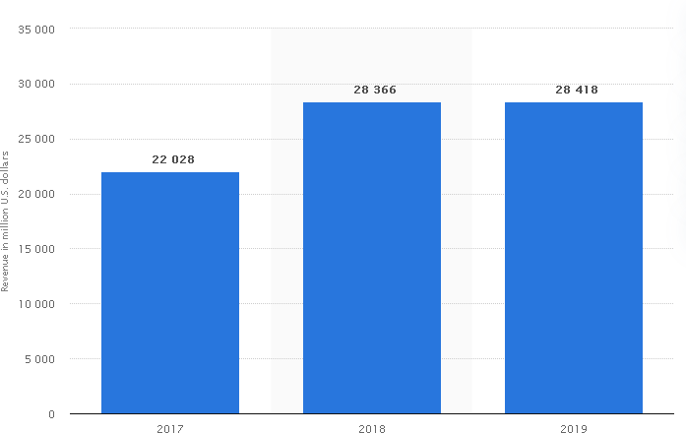
Financial benefits Maersk achieved using Block chain
Reduced cost of paper work: On an average the cost of paper work for international transport and clearance is about 15-20% of the cost of delivery. Using Block chain these costs were reduced by 70%-90% depending on the participating actors.
Reducing shipping time: Time were reduced by 40% from USA due to speeding workflow.
Reducton in number of steps: due to transparency of block chain technology the number of steps in operational question were drastically reduced.
Maersk's ocean segment revenue in FY 2017 and FY 2019 ("Maersk Ocean: revenue 2017-2019 | Statista", 2020)

Slide 27
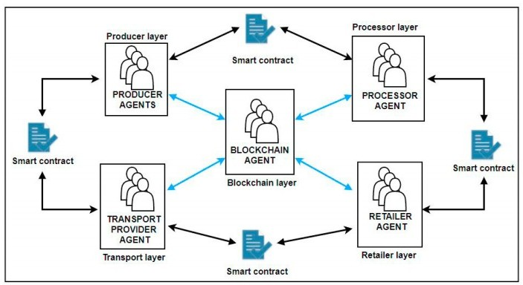
How Block chain Disrupt the Supply Chain?
Decentralization
Distributed ledger
Database stored in chronological order
Immutability
Accessibility
Security
Transparency
Auditability
Traceability
Quick response time
Smart contracts

Slide 28
How Block chain benefits the Supply Chain?
•
•
•
•
•
Eliminates the fraud
Quickens up the pace of tracking Improves inventory management Reduces the courier cost
Lessens the paperwork
Better monitoring of shipment

Slide 29
References
Chang, J. (2018). Blockchain Design for supply chain Management. SSRN Electronic Journal , 36.
Intrepid. (2020). The Blockchain Review. A Blockchain Technology Business Journal , 5.
Marco Iansiti, K. R. (2017 ). The Truth About Blockchain. Technology , 11.
Marr, B. (2018). How Blockchain Will Transform The Supply Chain And Logistics Industry. article , 4.
McKinsey. (2017 ). Blockchain technology for supply chains—A must or a maybe? Aricle , 7.
Mitra, R. (2019). Blockchain And Supply Chain: A Dynamic Duo. guides , 24.
Rizzo, P. (2016). World’s Largest Mining Company to Use Blockchain for Supply Chain Management. Supply Chain News , 4.
Rouse, M. (2019). What is supply chain management (SCM) and why is it important? Search ERP , 10.
SZEWCZYK, P. (2019). Application of Blockchain technology in supply chain management. SILESIAN: polsl.
Vorabutra, J.-A. (2016). Why Blockchain is a Game Changer for Supply Chain Management Transparency.
Supply Chain News , 4.

Slide 30




Slide 31
Learning Objectives
Upon completion of this material, you should
Explain the basic principles of cryptography, both symmetric and asymmetric encryption (and one-way hashes)
Describe the operating principles of the most popular tools in the area of cryptography
List the major protocols and algorithms used for secure communications
Discuss the nature and execution of the dominant methods of attack used against cryptosystems
be▪ able to:
2

Slide 32
Topics
Terminology
Cipher types
Substitution ciphers
Transposition ciphers
Exclusive OR
Hash functions
Encryption algorithms
Symmetric
Asymmetric
Tools
Digital signatures, digital certificates, PKI (Public Key Infrastructure)
Diffie-Hellman
Cryptanalysis

Slide 33
Introduction
Cryptography: process of making and using codes for the secure transmission of information
Encryption: converting original message (plaintext) into a form unreadable by unauthorized individuals (ciphertext).
Decryption: converting the encrypted message into the original message using authorized information
Cryptanalysis: process of an “adversary” obtaining original message from encrypted message with only partial information
Cryptology: science of encryption; combines cryptography and cryptanalysis (AMTH 387)
Principles of Information Security
5

Slide 34
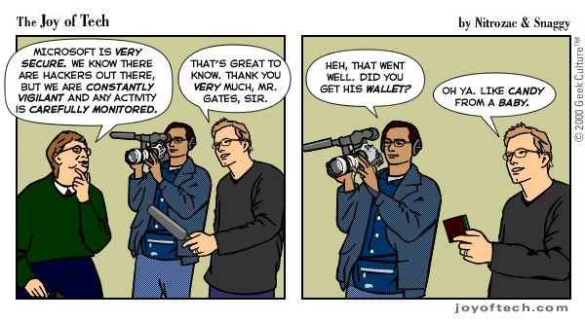
Foundations of Cryptology
Encryption is essential to securing digital data and modern ciphers are intended to be very hard to crack
However, sometimes the biggest vulnerability is not what you expect.
What is the biggest vulnerability in E-Commerce?
Principles of Information Security, 3rd edition
6

Slide 35
Categorizing of Encryption
Methods
1. Plaintext can be encrypted through bit (or character)
stream or block cipher method
Stream cipher: each plaintext bit transformed into cipher bit one bit at a time (or character by character)
Block cipher: message divided into blocks (e.g., sets of 32- or 128-bit blocks) and each is transformed into encrypted block of cipher bits using algorithm and key
Another category is number of keys – usually one or two (single or dual key / symmetric or asymmetric)
Third category: Type of operations – substitution, transposition, XOR (non-encrypting mathematical transforms, “proprietary method”)
Principles of Information Security
7

Slide 36
Encryption Methods
# of keys
Stream or block
Type of OP
Substitution – character, stream, shift forward by one to encrypt, shift back to decrypt
This is a test
Uijt jt b uftu

Slide 37
Cipher Methods
Substitution cipher: substitute one value for another
Monoalphabetic substitution: uses only
one alphabet for ciphertext
Uijt jt
Polyalphabetic substitution: more advanced; uses two or more alphabets
(sets of symbols)
Vigenère cipher: substitution cipher that uses simple polyalphabetic code; made up of 26 distinct cipher alphabets
Ujlw ..
Principles of Information Security

Slide 38

Principles of Information Security

Slide 39
Cipher Methods (continued)
Transposition cipher: rearranges values within a block to create ciphertext
this
isse cret
Exclusive OR (XOR): function of Boolean algebra; two bits are compared (still used today)
If two bits are identical, result is binary 0
If two bits not identical, result is binary 1
Principles of Information Security

Slide 40

Principles of Information Security

Slide 41
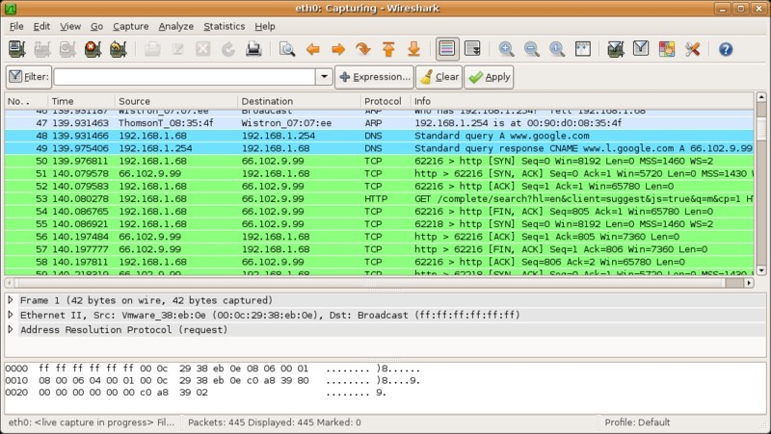
Network Reconnaissance Tool
Binary vs. hex
Principles of Information Security, 3rd edition
12

Slide 42
Cryptographic Hash Functions
Publically known mathematical algorithms that generate a fixed-length message summary/digest used to confirm message identity and confirm no content has changed (for integrity)
It is intended to be computationally infeasible to
generate a message that has a given hash
modify a message without changing the hash
find two different messages with the same hash
strong collision resistant property
Principles of Information Security

Slide 43
Cryptographic Hash Functions
Used in many password verification systems
Use of keys not required; message authentication code (MAC – hash encrypted with symmetric key), may be attached to a message
Examples:
md5 produces a 128 bit hash
Strong collision vulnerabilities
SHA-1 produces a 160 bit hash
Principles of Information Security

Slide 44
Cryptographic Algorithms
Often grouped into two broad categories, symmetric and asymmetric; today’s popular cryptosystems use hybrid (encapsulated) combination of symmetric and asymmetric algorithms
Symmetric and asymmetric algorithms distinguished by number and types (shared vs. public/private) of keys used for encryption and decryption operations
Symmetric is called ‘secret key’ or conventional cryptography
Asymmetric is called ‘public key’ cryptography
Principles of Information Security

Slide 45
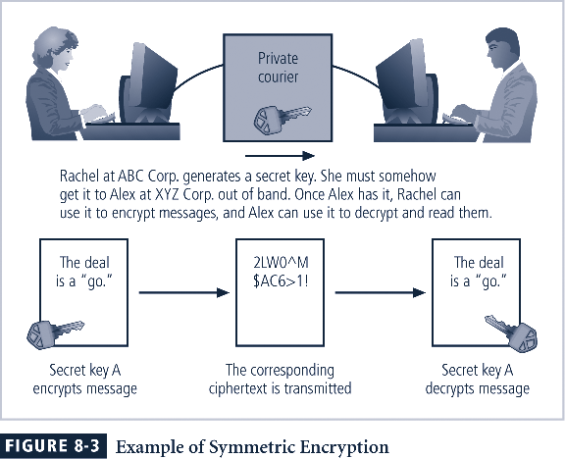
Principles of Information Security

Slide 46
Symmetric Encryption Algorithms
Symmetric encryption: uses same “secret key” to encode and decode message
Encryption methods can be extremely efficient, requiring minimal processing [hardware, software implementations]
Both sender and receiver must possess encryption key
If either copy of key is compromised, the encryption is no longer secure
Key distribution problem: if key is used too often, it is susceptible to cryptanalysis – how to securely distribute new key (concerns: data spills/key leakage and sample size to attack)
Principles of Information Security

Slide 47
Symmetric Encryption
Data Encryption Standard (DES): popular symmetric cryptosystem
64-bit block size; 56-bit key
Adopted by NIST in 1976 as federal standard for encrypting non-classified information
Triple DES (3DES): created to increased security while being somewhat compatible with DES
Increases effective key size by using 2 or 3 keys
ciphertext = EK3(DK2(EK1(plaintext)))
Advanced Encryption Standard (AES) replaced DES (as federal standard), 3DES in 2001 (built by community)
Can use 128, 192 or 256 bit key (or longer)
Principles of Information Security

Slide 48
Encryption Key Size
When using ciphers, size of key is very important
Strength of many encryption applications and cryptosystems measured by key size
For cryptosystems, security of encrypted data is not dependent on keeping encrypting algorithm secret
Cryptosystem security depends on keeping the key(s) secret
Principles of Information Security

Slide 49
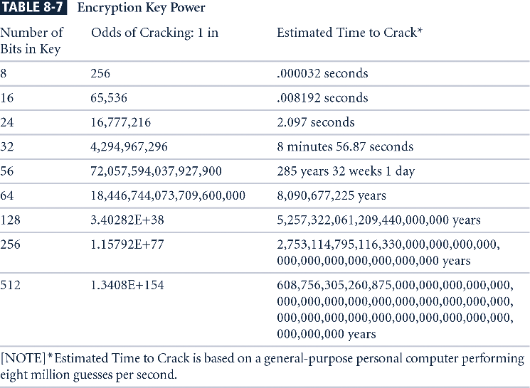
Table has been updated in the 4th edition
Principles of Information Security, 3rd edition
22

Slide 50
Cryptographic Algorithms - Asymmetric
Asymmetric encryption (public-key encryption)
Uses two different but related keys; either key can encrypt or decrypt message
If Key A encrypts message, only Key B can decrypt
Useful to have one key serve as private key and the other serve as public key
More computationally intensive than symmetric
Can be used for authentication as well as confidentiality
Principles of Information Security

Slide 51
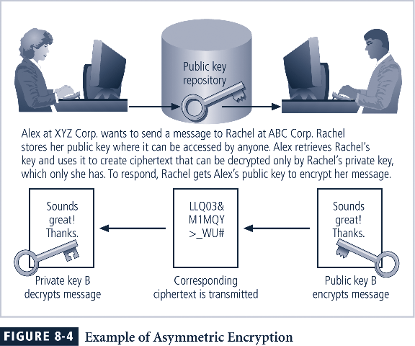
Principles of Information Security

Slide 52
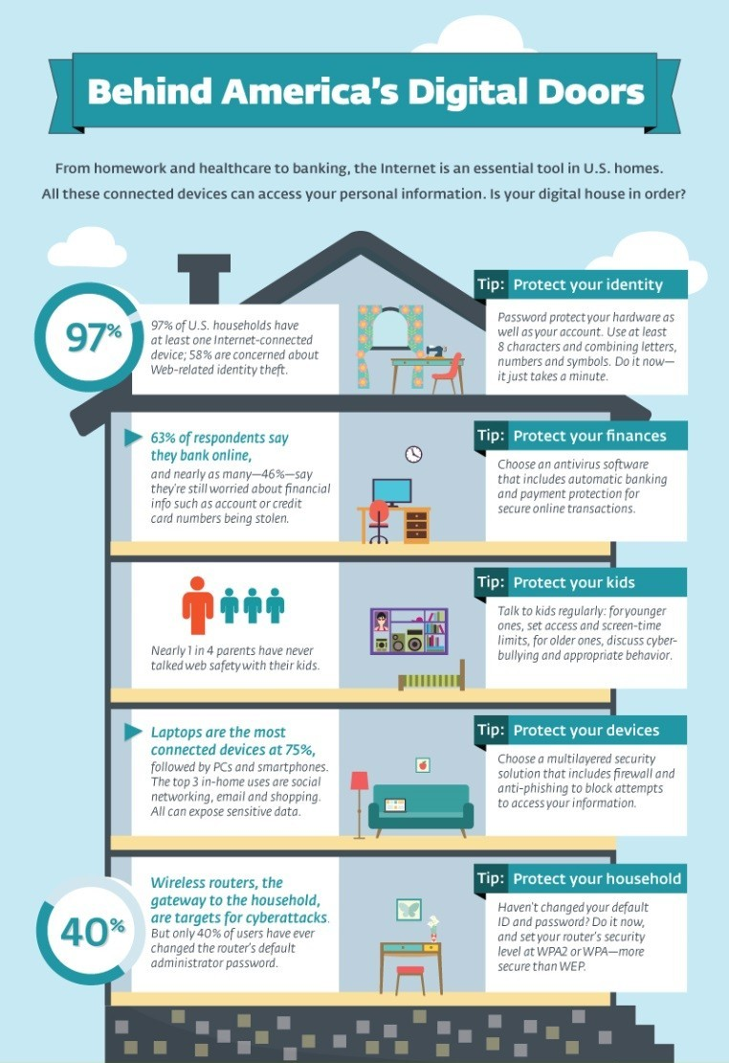


Useful References
Staysafeonline.org
Eff.org
https://www.schneier.com/crypto-gram/

Slide 53
Public Key Encryption
How would Alex and Rachel use public key encryption to ensure authentication as well as confidentiality?
That is, when Alex gets the message, how can he be sure it came from Rachel?

Slide 54
Features of Block Chains
--Digital Signatures
--Digital Certificates
--Hashing
--Encryption

Slide 55
Digital Signatures
Additions to messages so that the message can be mathematically proven to be authentic
Assuming private key has not been compromised
Created in response to rising need to verify information transferred using electronic systems
May be recognized as a legal signature in U.S.
Asymmetric encryption processes used to create digital signatures
Digital signature is a hash encrypted with a private key
Principles of Information Security
30

Slide 56
Digital Signature Idea
message
message
Ensures that the message has not been altered since being ‘signed’ with sender’s private key
H
E
Cryptographic hash function
Signer’s private key

Slide 57

Why We Need Digital Certificates
The problem with the public key cryptography scheme and digital signature idea so far discussed is, what if someone tampers with the public key repository?

Slide 58
Digital Certificates
Electronic document containing public key value and identifying information about entity that controls key
Digital signature attached to certificate’s container file to certify file is from entity it claims to be from
A CA such as Verisign creates a public- private key pair for you and puts the public key in a digital certificate.
Signed with Certificate Authority’s private key – your browser has CA’s public key
message
Principles of Information Security
33

Slide 59
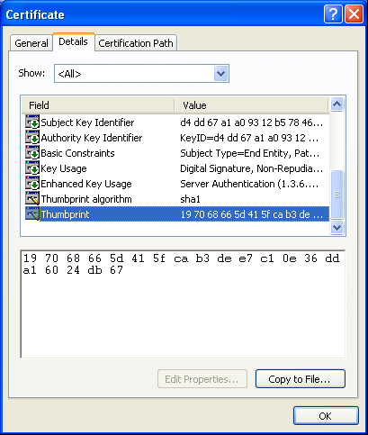
Digital Certificate Example
Principles of Information Security, 3rd edition
34

Slide 60
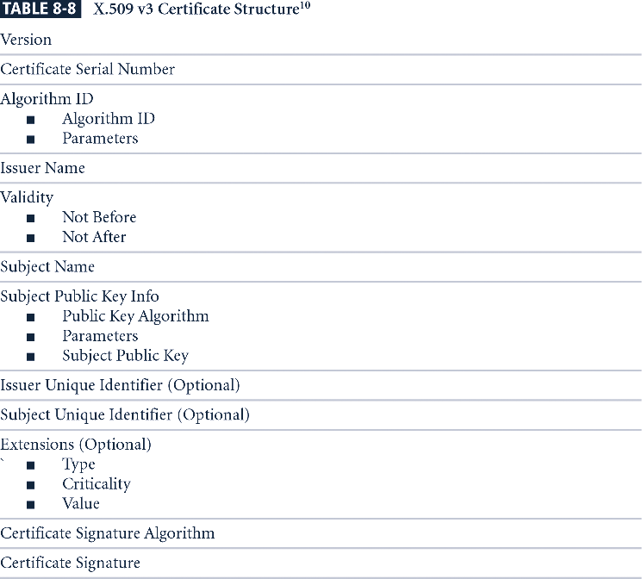
Signature is hash of certificate encrypted with private key of CA
Principles of Information Security

Slide 61
Cryptographic Tools, PKI
Public Key Infrastructure (PKI): integrated system of software, encryption methodologies, protocols, legal agreements (CPS), and third-party services enabling users (relying parties) to communicate securely
PKI systems based on public-key cryptosystems; include digital certificates and certificate authorities (CAs)
Two CA’s were compromised in 2011 (Diginotar)
Browsers prepopulated with trusted roots
Equifax, GlobalSign, DigiCert, GoDaddy and Verisign are “Root CA’s” and must pass audits by external security firms
Principles of Information Security
Notes:
Certification Practice Statement (CPS)

Slide 62
Cryptography Tools (continued)
PKI protects information assets in several ways:
Authentication
Integrity
Privacy
Authorization
Nonrepudiation
Principles of Information Security

Slide 63
Hybrid Cryptography Systems
Asymmetric encryption more often used with symmetric key encryption, creating hybrid system
Conventional encryption is faster
Don’t want to “overuse” a key.
PKI or digital certificates used to agree on symmetric ‘session’ key
Diffie-Hellman Key Exchange method: means for secure distribution of secret keys; provided foundation for subsequent developments in public-key encryption
Principles of Information Security

Slide 64
Diffie Hellman Key Exchange
Alice and Bob want to agree on a secret key but have only an insecure communications channel.
They agree on a finite cyclic group and a generating element of that group.
Usually a multiplicative group of integers modulo P, where P is a large prime number and a generating element G.
They must assume the attacker knows P and G and any message they exchange.
Alice and Bob each choose a secret integer, a and b
Alice sends Bob Gª mod P
Bob sends Alice G^{b} mod P
Both compute G^{ab} mod P which will be their secret key

Slide 65
Steganography
Process of hiding information; in use for a long time
Most popular modern version hides information within files appearing to contain digital pictures or other images
Some applications hide messages in
.bmp, .wav, .mp3, and .au files, as well as in unused space on CDs and DVDs
Principles of Information Security

Slide 66
Protocols for Secure Communications
Secure Socket Layer (SSL) protocol: uses public key encryption to secure channel over public Internet; operates at the Transport layer
Transport Layer Security (TLS) replaces SSL and also uses asymmetric cryptography for authentication of key exchange, symmetric encryption for confidentiality, and message authentication codes for message integrity
Secure Hypertext Transfer Protocol (S-HTTP): extended version of Hypertext Transfer Protocol; provides for encryption of individual messages between client and server across Internet using a virtual connection
S-HTTP is the application of SSL over HTTP (application and transport layer work together)
Variation of the more popular HTTPS
Principles of Information Security

Slide 67
Internet Protocol Layers
telnet | FTP | SMTP | HTTP |  | RPC
TCP |  |  |  | UDP
IP and ICMP |  |  |  |  |  | ARP
MAC and Link
Physical
Application layer
Transport layer
Network
Datalink and physical

Slide 68
Protocols for Secure Communications (continued)
Securing e-mail with S/MIME, PEM, and PGP
Secure Multipurpose Internet Mail Extensions (S/MIME): builds on Multipurpose Internet Mail Extensions (MIME) encoding format by adding encryption and authentication
Privacy Enhanced Mail (PEM): proposed as standard to function with public-key cryptosystems; also uses 3DES symmetric key encryption
Pretty Good Privacy (PGP): can use several different ciphers for message encoding
Principles of Information Security

Slide 69

Protocols for Secure Communications
Secure Electronic Transactions (SET): developed by MasterCard and VISA in 1997 to provide protection from electronic payment fraud
Uses RSA for key exchange and DES to encrypt credit card information
Provides security for both Internet-based credit card transactions and credit card swipe
systems in retail stores
Replaced by 3-D Secure
Can I trust the
Is the credit card good?
merchant
Merchant?
customer
Is this really the price he approved?
bank
Principles of Information Security

Slide 70
Protocols for Secure Communications
Securing Wireless Networks with WEP, WPA and WPA2
Wired Equivalent Privacy (WEP): early attempt to provide security with the 802.11 network protocol
Used RC4 in an insecure way
Wi-Fi Protected Access (WPA): created to resolve issues with WEP (but had to be similar for compatibility reasons)
WPA2 is the real solution; uses AES
Bluetooth: de facto industry standard for short range wireless communications between devices; can be exploited by anyone within approximately 30 foot range, unless suitable security controls are implemented
Principles of Information Security

Slide 71
Protocols for Secure Communications (continued)
Securing TCP/IP with IPSec (network layer)
Internet Protocol Security (IPSec): open source protocol to secure communications across any IP- based network
IPSec designed to protect data integrity, user confidentiality, and authenticity at IP packet level
IPSec combines several different cryptosystems: Diffie-Hellman; public key cryptography; bulk encryption algorithms; digital certificates
IPv6 starting to be used since they ran out of addresses
Principles of Information Security

Slide 72

Protocols for Secure Communications
Pretty Good Privacy (PGP): hybrid cryptosystem designed in 1991 by Phil Zimmermann
Combined best available cryptographic algorithms to become open source de facto standard for encryption and authentication of e- mail and file storage applications
Freeware and low-cost commercial PGP versions are available for many platforms
PGP security solution provides six services: authentication by digital signatures; message encryption; compression; e-mail compatibility;
segmentation; key management
Principles of Information Security

Slide 73
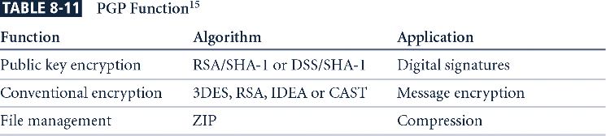
PGP can use Digital Envelopes
First, the message itself is encoded using symmetric encryption, and then this session key to decode the message is encrypted using the recipient’s public key.
This technique overcomes one of the problems of public- key encryption, which is that it is slower than symmetric encryption. Because only the key is protected with public-
key encryption, there is very little overhead.
Principles of Information Security

Slide 74
Attacks on Cryptosystems
Attacks on cryptosystems fall into four general categories
Man-in-the-middle: get plaintext/ciphertext pair or trick-you-into-revealing-the-key
Correlation attacks and statistical analysis
Dictionary attack: for short phrases or passwords where the cryptosystem is known
Timing attack: deduce info from timing
patterns
Principles of Information Security

Slide 75

51

Slide 76
Man-in-the-Middle Attack
Anytime an attacker intercepts messages of two legitimate parties to trick them into accepting his message as legitimate.
Intercept transmission of public key or insert known key structure in place of requested public key
From victim’s perspective, encrypted communication appears to be occurring normally, but in fact attacker receives each encrypted message, decodes, encrypts, and sends to originally intended recipient
Establishment of public keys with digital signatures can prevent traditional man-in-the-middle attack
Principles of Information Security

Slide 77
Correlation Attacks and Classical Cryptanalysis
Collection of brute-force methods that attempt to deduce statistical relationships between structure of unknown key and ciphertext
Differential and linear cryptanalysis have been used to mount successful attacks
Correlation attacks can only be used on certain stream ciphers where some of the plaintext is known or can be guessed
Principles of Information Security

Slide 78
Dictionary Attacks
Origin of phrase: Attacker encrypts every word in a dictionary using same cryptosystem used by target
Dictionary attacks can be successful when the ciphertext consists of relatively few characters (e.g., usernames, passwords)
UNIX password file:
Your password is not stored as clear text
your password is used as a key to encrypt a known value which is stored.
Vulnerable to dictionary attacks
Principles of Information Security

Slide 79
Timing Attacks
Attacker eavesdrops during victim’s session; uses statistical analysis of user’s typing patterns and inter-keystroke timings to discern sensitive session information
Can be used to gain information about encryption key and possibly cryptosystem in use
Information does not break encryption but adds to knowledge that can be used in other attacks
Principles of Information Security

Slide 80
Summary
Key management is not so much management of technology but rather management of people
Cryptography and encryption provide sophisticated approach to security
Encryption converts a message into a form that is unreadable by the unauthorized
Many tools are available and can be classified as symmetric or asymmetric, each having advantages and special capabilities
Principles of Information Security

Slide 81
Summary (continued)
Strength of encryption tool is dependent on key size but even more dependent on following good management practices
Cryptography is used to secure most aspects of Internet and Web uses that require it, drawing on extensive set of protocols and tools designed for that purpose
Cryptosystems are subject to attacks that
fall into four categories
Principles of Information Security

Slide 82
Terms to Know
Plain text, ciphertext, substitution, transposition
Vigenere, Vernam
DES, Triple DES, AES, RSA
Hash function, message digest
Symmetric or secret key encryption
Asymmetric or public key encryption
SSL, PGP, IPSec
Digital signatures, PKI, Certificate authority

